Slide 1
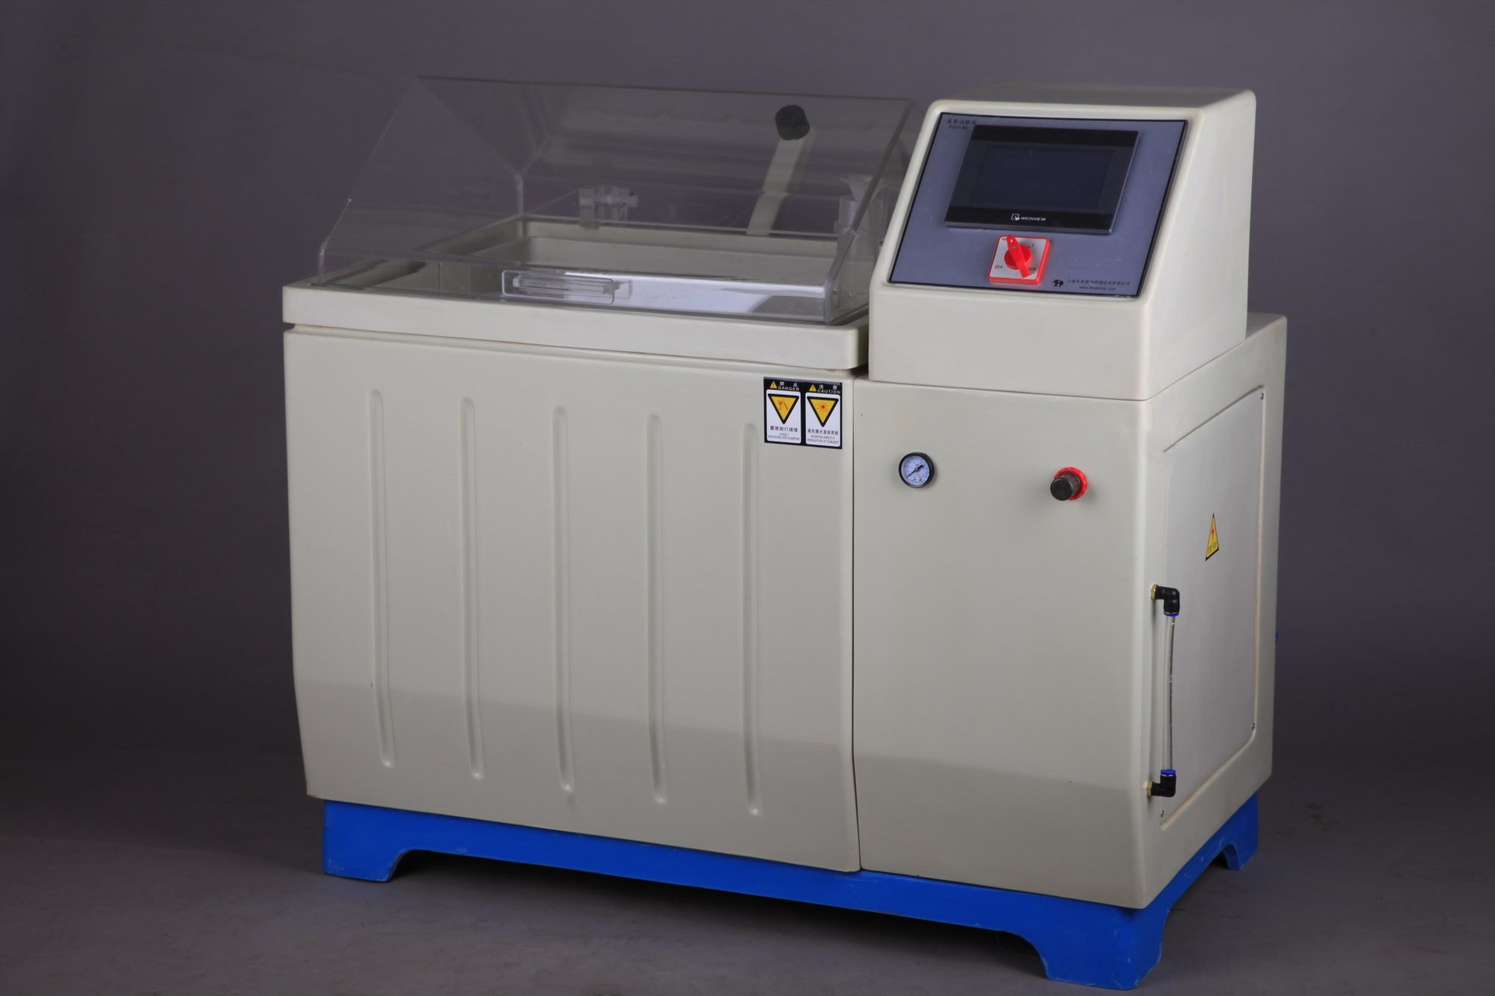
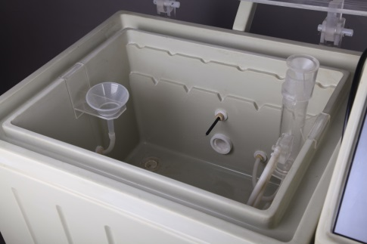
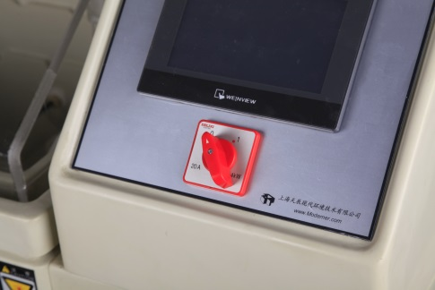
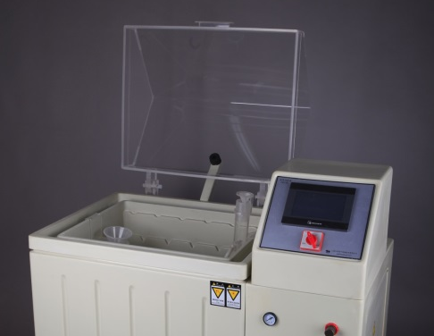
SALT FOG CABINETS
The FQY series Salt Fog Apparatus is capable of simulating ocean climate condition. It performs salt fog corrosion test for coating of paint, cladding of manufactured product, electro technical equipment, electronic component, and metallic material, etc. and test the anti-corrosion quality of all the materials
It complies with National Standard GB2423.17 (Basic Circumstance Test Regulations of Electric & Electronic Products Test: Salt Spray Test Method), IEC68-2-11 (Second Part of Test Rules under Basic Environment: Test, Test: Salt Fog) and ISO9227 (Artificial Simulating Weathering Corrosion Test-Salt Spray Test) to do salt spray test.
The FQY series are designed and manufactured by our company is in accordance with the specification of ISO9227

Slide 2
Standards
ASTM-B117, JIS-D0201, JIS-H8502, JIS-H8610, JIS-Z2371, GB/T 10125, ISO9227
Technical Specification
Model | FQY-015 | FQY-025 | FQY-075 | FQY-100 | FQY-160 | FQY-200
Internal Dimension (mm) | 630×500× 450 | 900×550× 600 | 1100×750× 600 | 1300×1000× 600 | 1600×900× 900 | 2000×1000× 600
External Dimension (mm) | 1330×850× 1300 | 1600×900× 1300 | 1800×1100× 1500 | 2000×1250× 1600 | 2300×1250× 1600 | 2800×1400× 1600
Volume (L) | 150 | 250 | 750 | 1000 | 1600 | 2000
Temperature | Room Temperature -60℃
Tolerance | ≤±2℃
Fluctuation | ≤±0.5℃
Drain | 1-2ml/80cm²·h
Spray Frequency | Continuous, weekly schedule
Power | 3Kw |  | 4Kw |  | 8Kw
Voltage | 220V, 50Hz
Ordering information
Product Ref | Dimension
FQY-015 | 630×500×450
FQY-025 | 900×550×600
FQY-075 | 1100×750×600
FQY-100 | 1300×1000×600
FQY-160 | 1600×900×900
FQY-200 | 2000×1000×600
+86 2159884839

